Slide 1

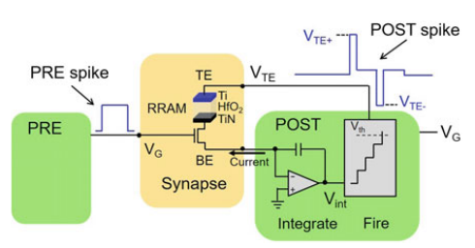
Integrate and Fire Model: A neural spiking circuit
Presented by Yashas Jha
Supervised by
Prof. Sandip Mandal
EE Dept, IITB
Notes:
It is a mathematical model that describes the behavior of individual neurons in a neural network.

Slide 2
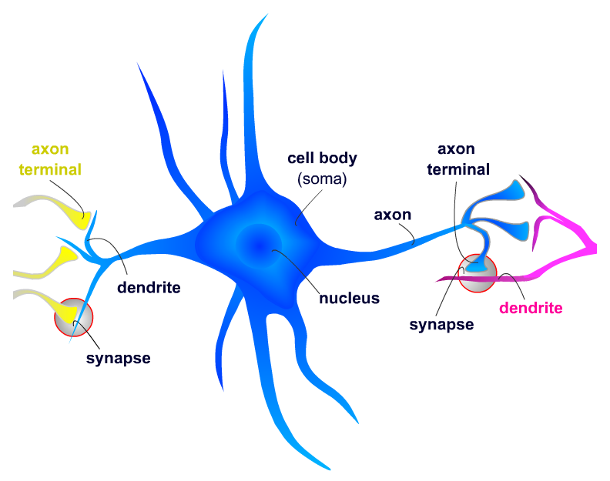
The natural neural network of the Brain
Our brain processes information basically by the means of neurons.
The neuron is majorly made of 4 distinct parts:
1) Soma: It is the cell body of the neuron and acts as its metabolic centre as well as its
manufacturing and recycling plant.
2) Axon and dendrites: The dendrites receive the incoming information from other
neuron. This information travels through the axon.
3) Axon terminals: These structures contain the neurotransmitters.
4) Synapse: These are the junctions where two neurons
are physically connected to one another through
gap junctions. These gap junctions allow changes in
electrical properties of one neuron to affect another
and vice-versa.
Notes:
Neurotransmitters are the chemical medium through which signals flow from one neuron to the next at chemical synapses.

Slide 3
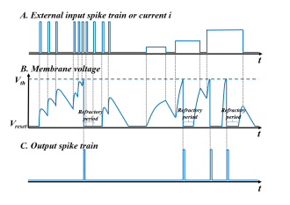
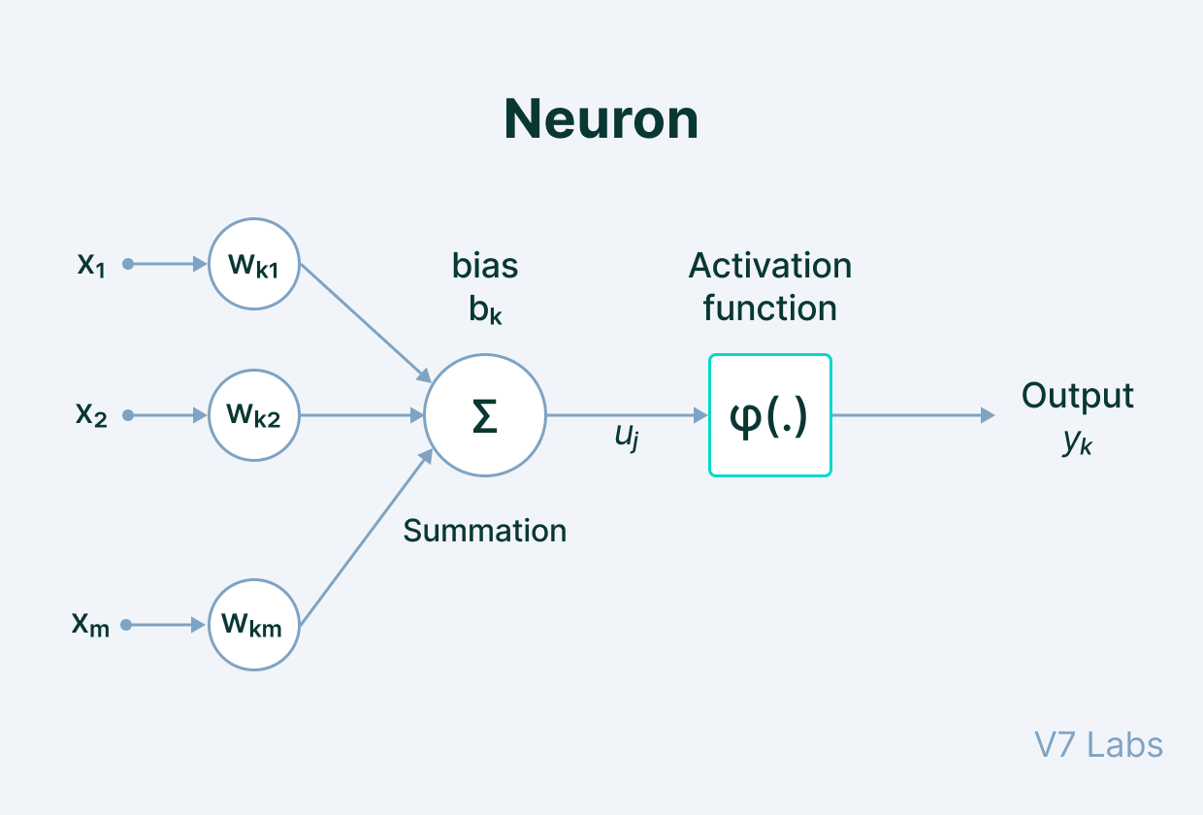
Spiking Neural Networks- An overview
It is a type of artificial neural network wherein, neurons communicate with each other using spikes via synapses.
These neural networks work similarly to the natural neural networks such as in the brain.
In such networks, pulse from multiple neurons are collected and added. This results in an increase in the potential of the membrane. When a certain threshold voltage gets reached, an output spike is generated.

Slide 4
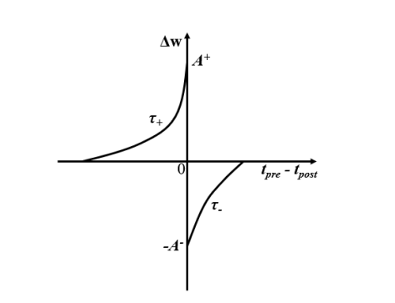
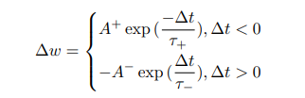
STDP
STDP (Spike Timing Dependent Plasticity) is a biological process in which the strengths of the connections between neurons are adjusted.
These adjustments take place on the basis of the precise timings of the spikes.
The timing difference between the pre-spike and post-spike will lead to either long-term potentiation or long-term depression.
When the pre-spike precedes the post-spike, it results in long-term
potentiation. And in the vice versa situation, long-term
depression takes place.
Notes:
Plasticity is the ability of the brain to change and adapt to new information. Long term potentiation means persistent strengthening of the synapses that lead to a long-lasting increase in signal transmission. Ltd is decrease in synaptic strength. A+ is the amplitude of potentiation and A- is the amplitude of depression. Tao+ is the rising time constant and Tao- is the falling time constant.

Slide 5
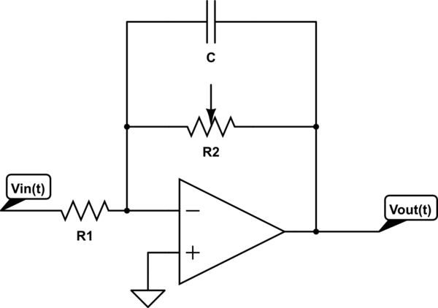
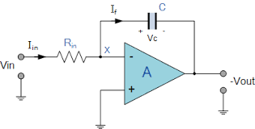
The Integrating Circuit
The integrating circuit receives spikes from different neurons and integrates it with respect to time.
An op amp with a capacitor in the negative feedback loop
can be employed as an integrator.
Since, the neuron undergoes a leaky integration, we add
a resistor in parallel to the capacitor.

Slide 6
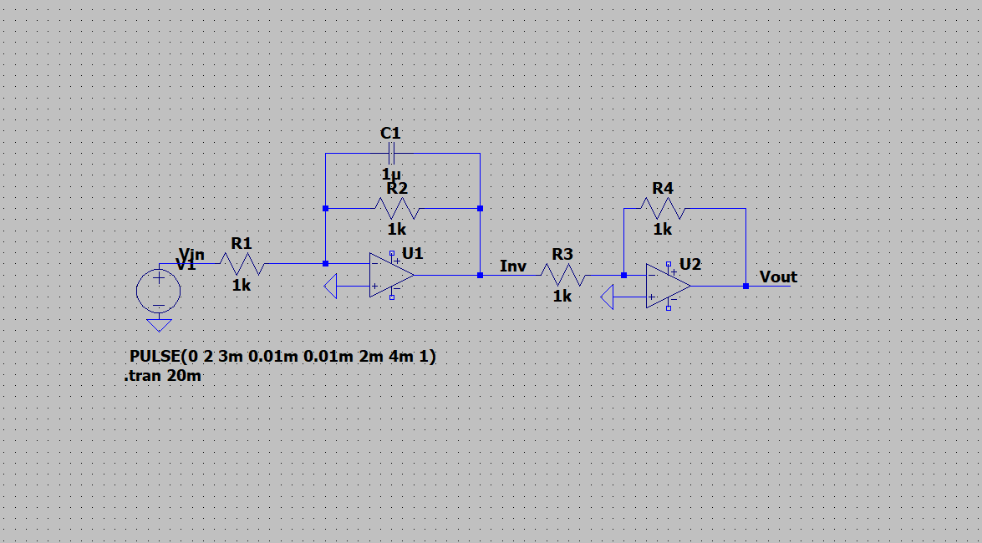
In our model, we have also connected a voltage controlled switch in parallel to the capacitor and resistor, such that when the threshold voltage of the neuron is reached, the capacitor discharges at an instant.
Since, we have used an inverting integrator, we connect an inverting amplifier in series to get a non-inverted amplified signal.
Circuit without the voltage controlled switching

Slide 7
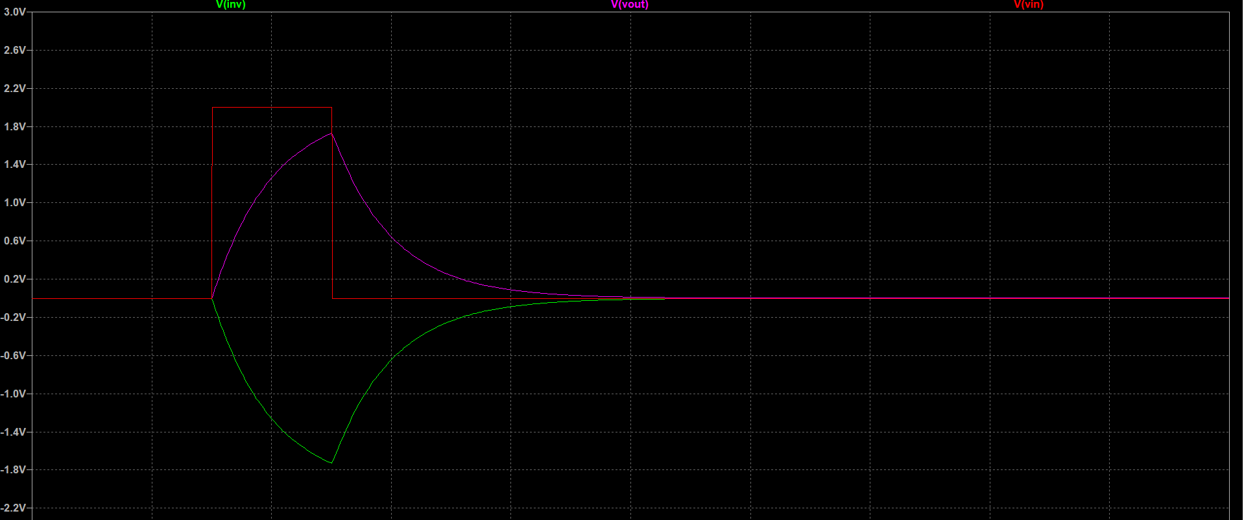
Simulation results of the circuit

Slide 8
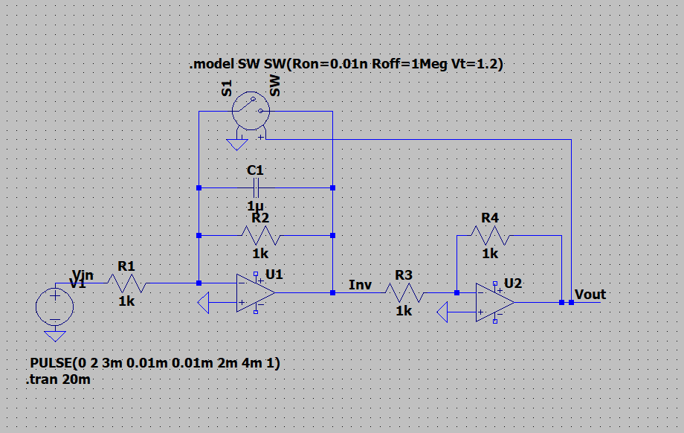
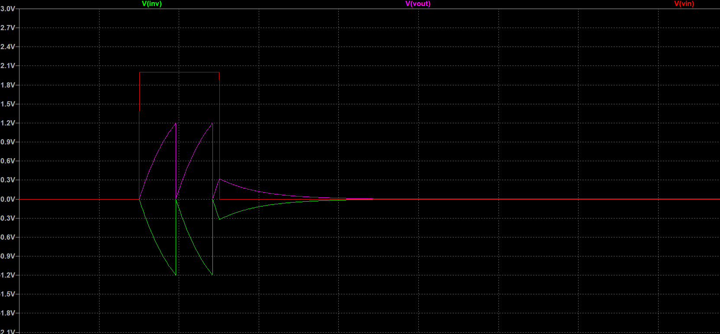
This is the circuit with the voltage controlled switch employed. In the simulations, we can see that as soon as the potential voltage of the membrane has been reached (which in this case is 1.2V), the capacitor discharges immediately.

Slide 9
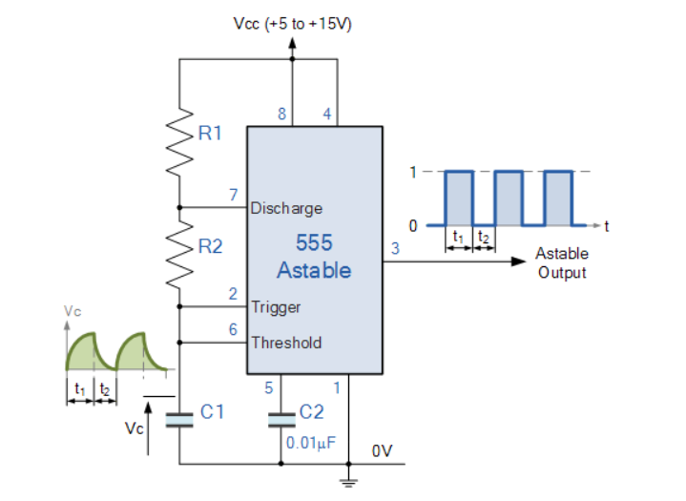
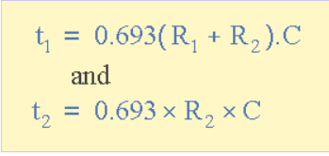
The Spike generating circuit
We have used a 555-timer to create a spike generating circuit. The timer is used in its astable oscillator configuration.
The components; R1, R2 and C1 are responsible for the
on and off time of the output wave.
Notes:
1 and 8 power the module. 4 is the reset pin and is connected to Vcc to avoid accidental resets. 5 is the control pin and we do not use it, hence it is connected to a capacitor to avoid high frequency noises. 2 and 6 connected to the capacitor which determines the output and the 7 pin is used for the discharge of the capacitor.

Slide 10
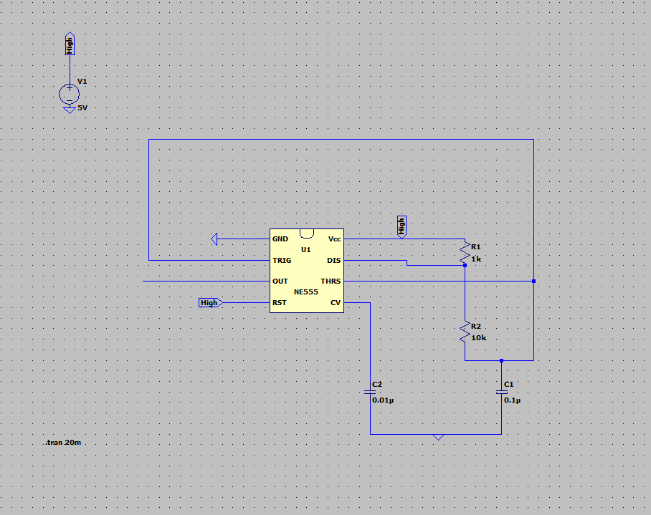
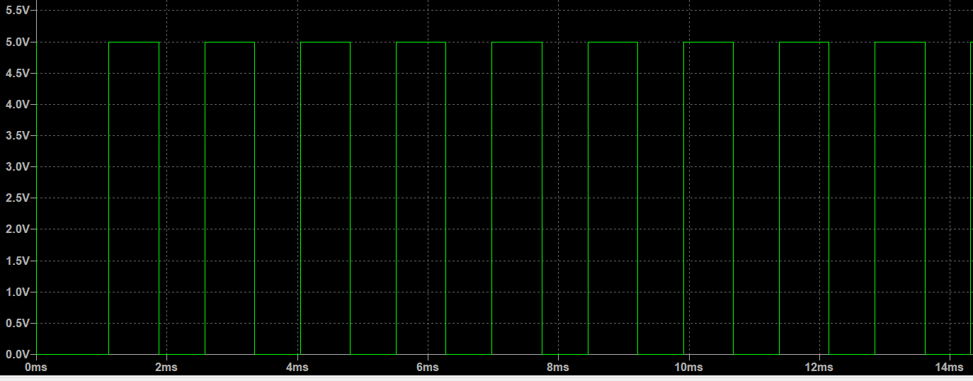
In our circuit we have selected the values of resistors R1 and R2 and the capacitor C1 such that we have a large number of spikes being produced every second.
Here too, we have added a voltage controlled switch between the supply and the timer such that the circuit is activated only after the threshold voltage has been reached.

Slide 11
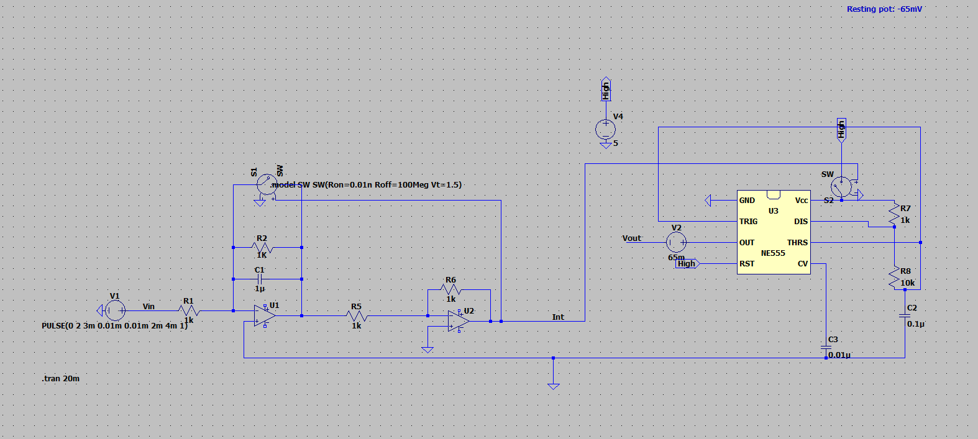
When both these individual circuits are connected together, we are able to achieve the following: 1. the membrane has a leaky integration and when the threshold voltage of the membrane is reached, the capacitor discharges immediately.
2. at the instant this threshold voltage has been reached, the spiking circuit is switched on and a spike is generated.

Slide 12
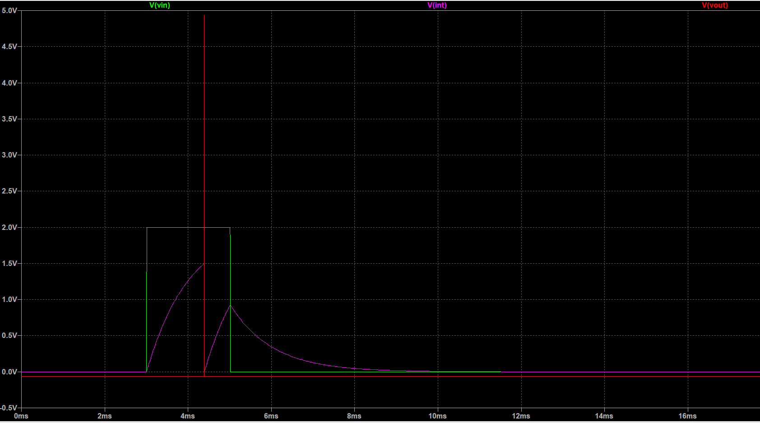
Result of the simulations

Slide 13
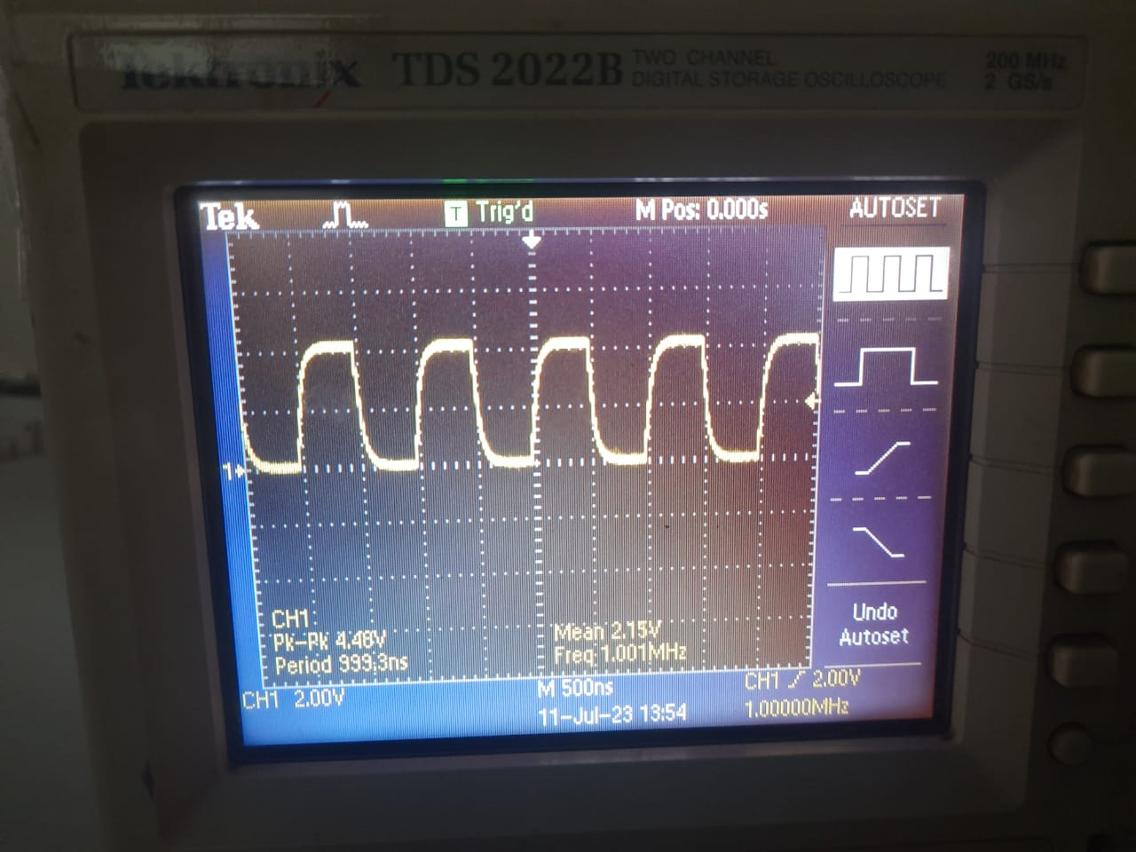
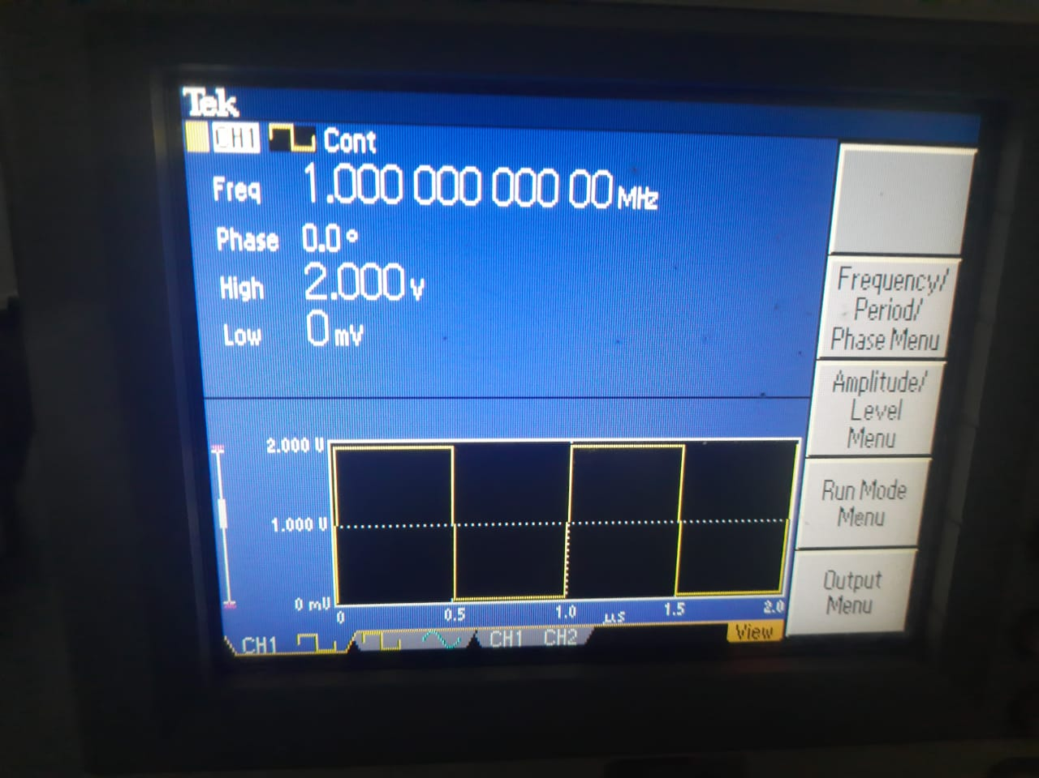
Output of the integrating circuit
Input to the integrating circuit

Slide 14
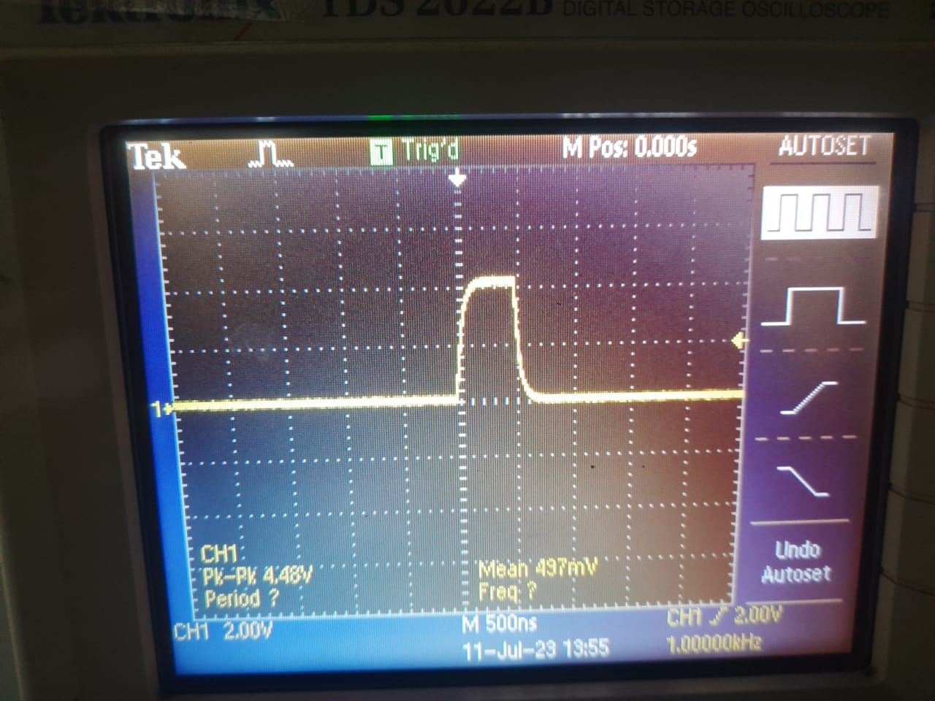
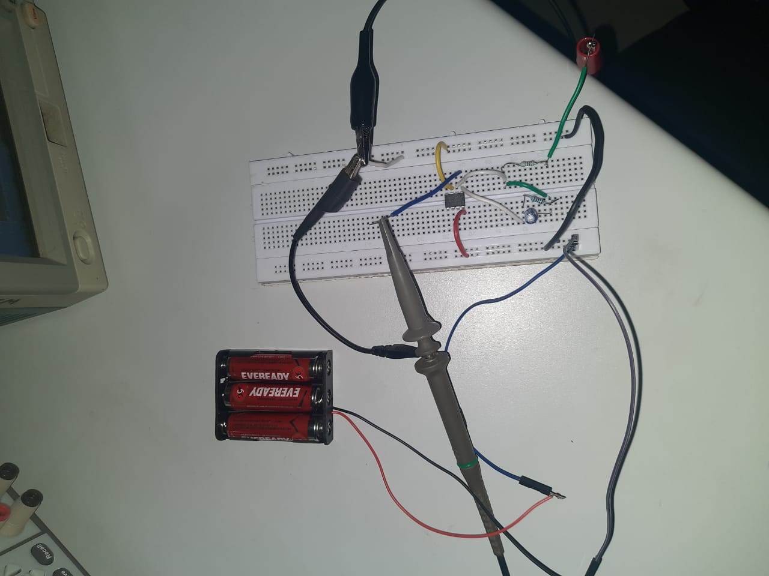
Output of the integrating subject when a single pulse is given as input
The integrating circuit

Slide 15
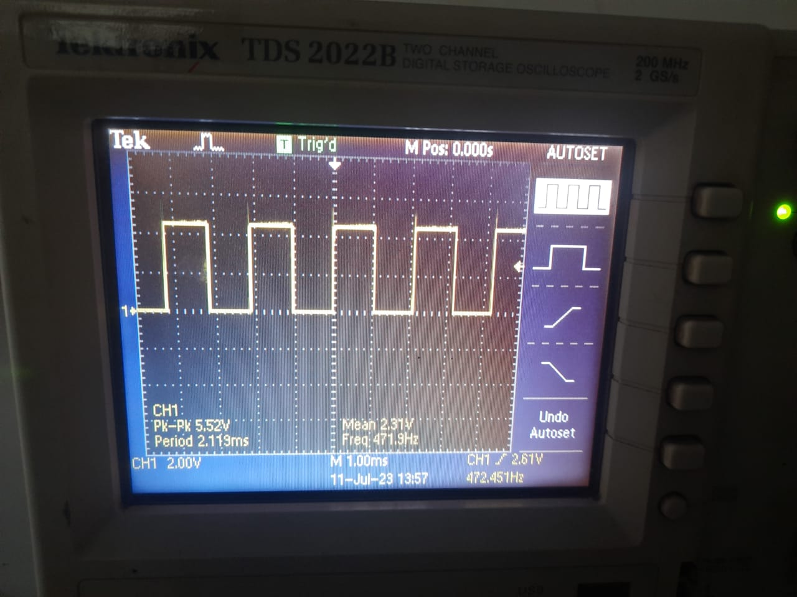
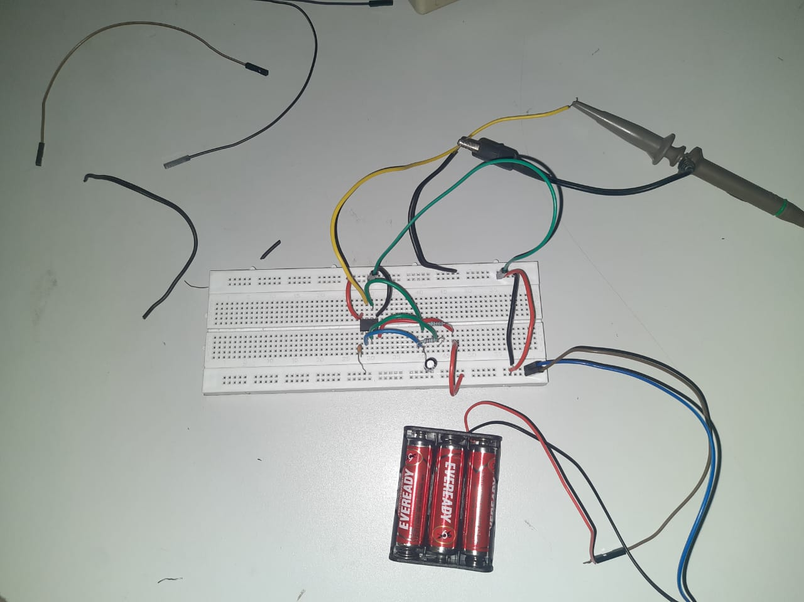
Output of the spike generating circuit
The spike generating circuit

Slide 16
THANK YOU

